Slide 1



Plant Disease Classification
INTERNSHIP_1736246007677d02f700dbe

Slide 2

Learning Objectives
Understand Plant Pathology Concepts:
Identify common plant diseases and their symptoms.
Machine Learning and Model Building:
Understand the fundamentals of classification algorithms, particularly convolutional neural networks (CNNs).
Implement and train models for image classification.
Evaluate model performance using appropriate metrics.
Deployment and Practical Application:
Develop a user-friendly interface for real-world applications (e.g., web app, mobile app).
Understand the process of deploying a machine learning model for practical use.
GOAL
Source :
www.freepik.com/

Slide 3

Tools and Technology used
Programming Languages
Python: Widely used for machine learning and computer vision.
Machine Learning Frameworks and Libraries
TensorFlow/Keras: For building and training deep learning models.
Computer Vision Tools
OpenCV: For image processing tasks like resizing, filtering, and augmentation.

Slide 4
Data Handling and Analysis
Pandas: For handling datasets and dataframes.
NumPy: For numerical operations and handling arrays.
Deployment Tools
Streamlit: For quick and easy model demos with user-friendly interfaces.
Development and Collaboration
GitHub/GitLab: For version control and collaboration.
Google Colab: For development, prototyping, and visualization.

Slide 5

Methodology
Data Preprocessing:
Image Resizing: Standardize image dimensions for the CNN input.
Normalization: Scale pixel values to a range (e.g., 0 to 1) for faster convergence.
Data Augmentation: Apply transformations like rotation, flipping, zooming, and brightness adjustments to increase dataset diversity.
Train-Test Split: Divide data into training, validation, and testing sets.
Model Architecture Design:
CNN Layers: Stack convolutional layers, pooling layers, and activation functions (e.g., ReLU).
Dropout Layers: Prevent overfitting by randomly dropping neurons during training.
Fully Connected Layers: Flatten the feature maps and pass them through dense layers for final classification.
Model Training:
Loss Function: Use categorical cross-entropy for multi-class classification.
Early Stopping: Stop training when validation loss stops improving.

Slide 6
Model Evaluation:
Metrics: Evaluate performance using accuracy, precision, recall, and F1-score.
Confusion Matrix: Analyze model predictions across classes.
Visualization: Use loss/accuracy curves to monitor training progress.
Deployment:
Export the trained model.
Deploy using Streamlit for web app.

Slide 7

Problem Statement:
Plant diseases significantly impact agricultural productivity, leading to reduced crop yields and economic losses. Early and accurate detection of plant diseases is crucial for timely intervention and effective crop management. Traditional methods of disease identification rely on manual inspection, which is time-consuming, error-prone, and requires expert knowledge.
This project aims to develop an automated plant disease classification system using Convolutional Neural Networks (CNNs) to accurately identify diseases from plant leaf images. The goal is to provide farmers and agricultural professionals with a reliable tool to enhance disease detection, improve crop health management, and increase agricultural efficiency.

Slide 8
Solution:
This project proposes an automated plant disease classification system using Convolutional Neural Networks (CNNs) to improve early detection and diagnosis. The process involves collecting a diverse dataset of healthy and diseased plant leaf images, followed by preprocessing techniques like resizing, normalization, and data augmentation to enhance model performance. A CNN architecture is designed to extract key features from the images, enabling accurate disease classification. The model is trained and optimized using techniques such as the Adam optimizer and categorical cross-entropy loss, with performance evaluated through accuracy, precision, recall, and F1-score. Finally, the trained model is deployed as a user-friendly application, providing farmers and agricultural professionals with instant disease predictions and recommended actions, helping reduce crop loss and improve agricultural productivity.

Slide 9
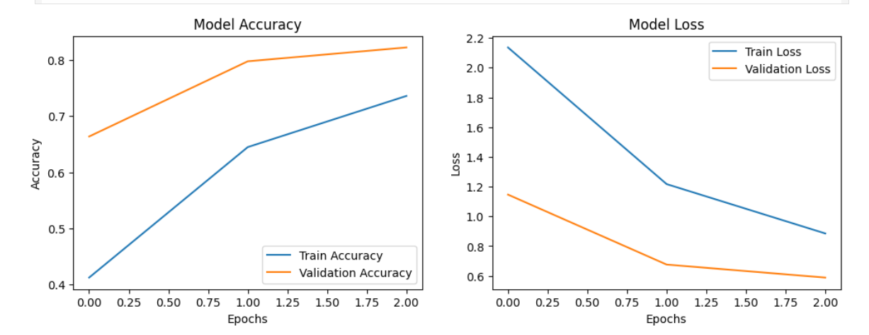
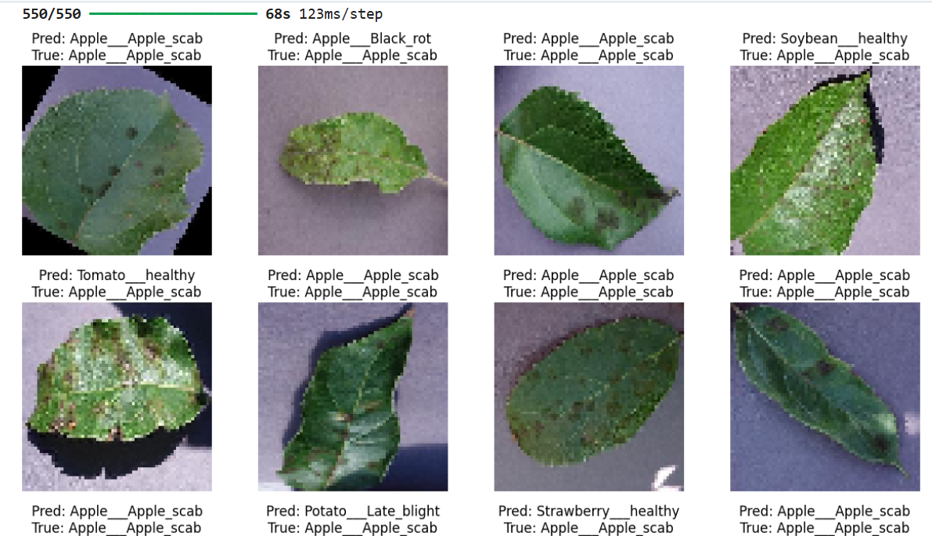
Screenshot of Output:

Slide 10
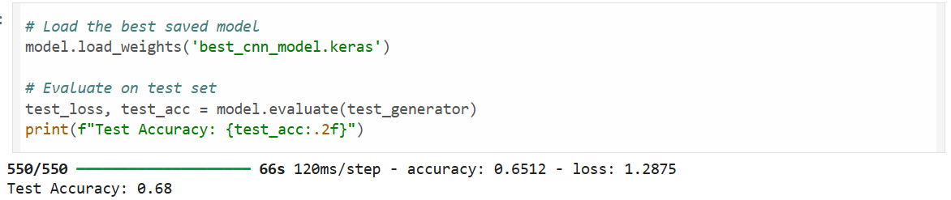
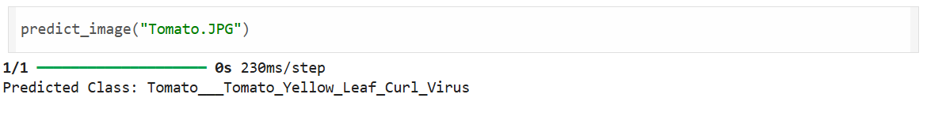


Slide 11
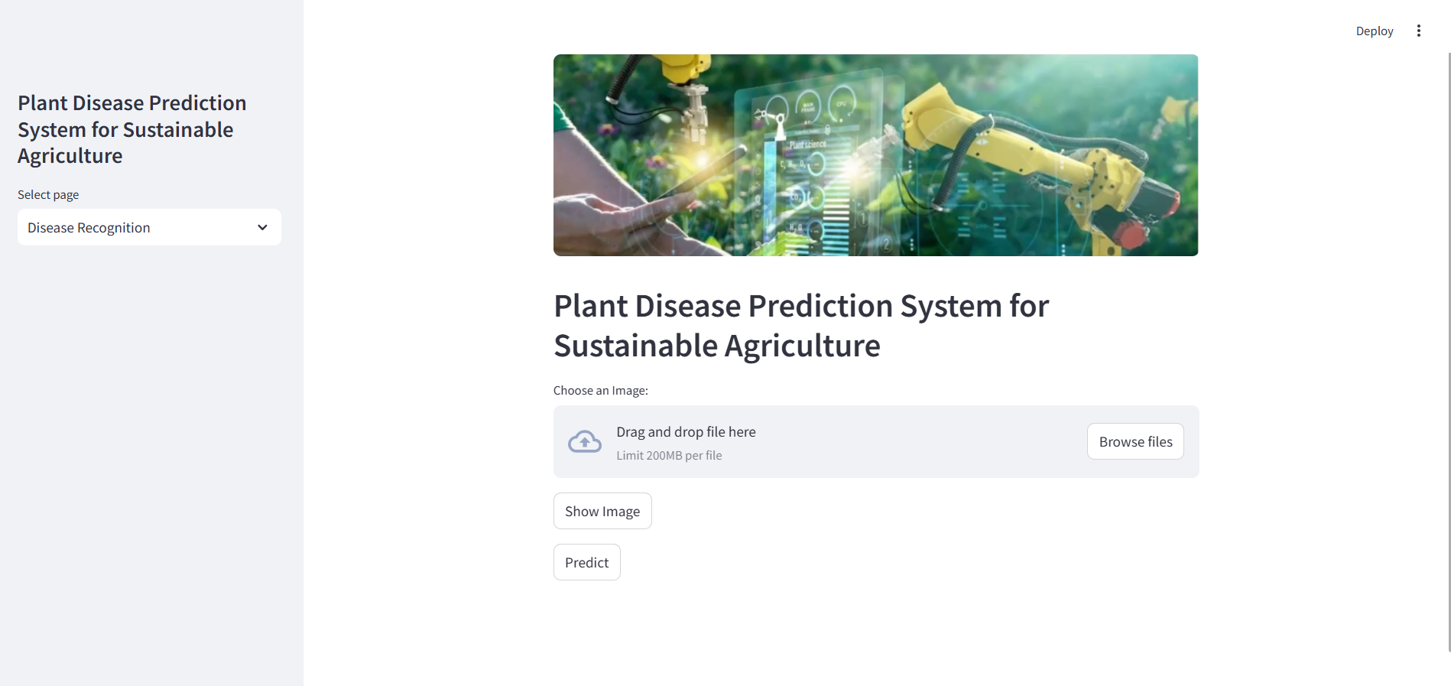

Slide 12

Conclusion:
In conclusion, the plant disease classification system using Convolutional Neural Networks (CNNs) provides an efficient and accurate solution for early disease detection. By automating the identification process, this system reduces the reliance on manual inspection, enabling quicker responses and better crop management. The model's strong performance, coupled with a user-friendly deployment, makes it accessible for farmers and agricultural professionals to make informed decisions, ultimately helping to minimize crop losses and improve agricultural productivity. Future work can focus on expanding the dataset, improving model accuracy, and deploying the system in real-world agricultural environments for broader impact.

Slide 13
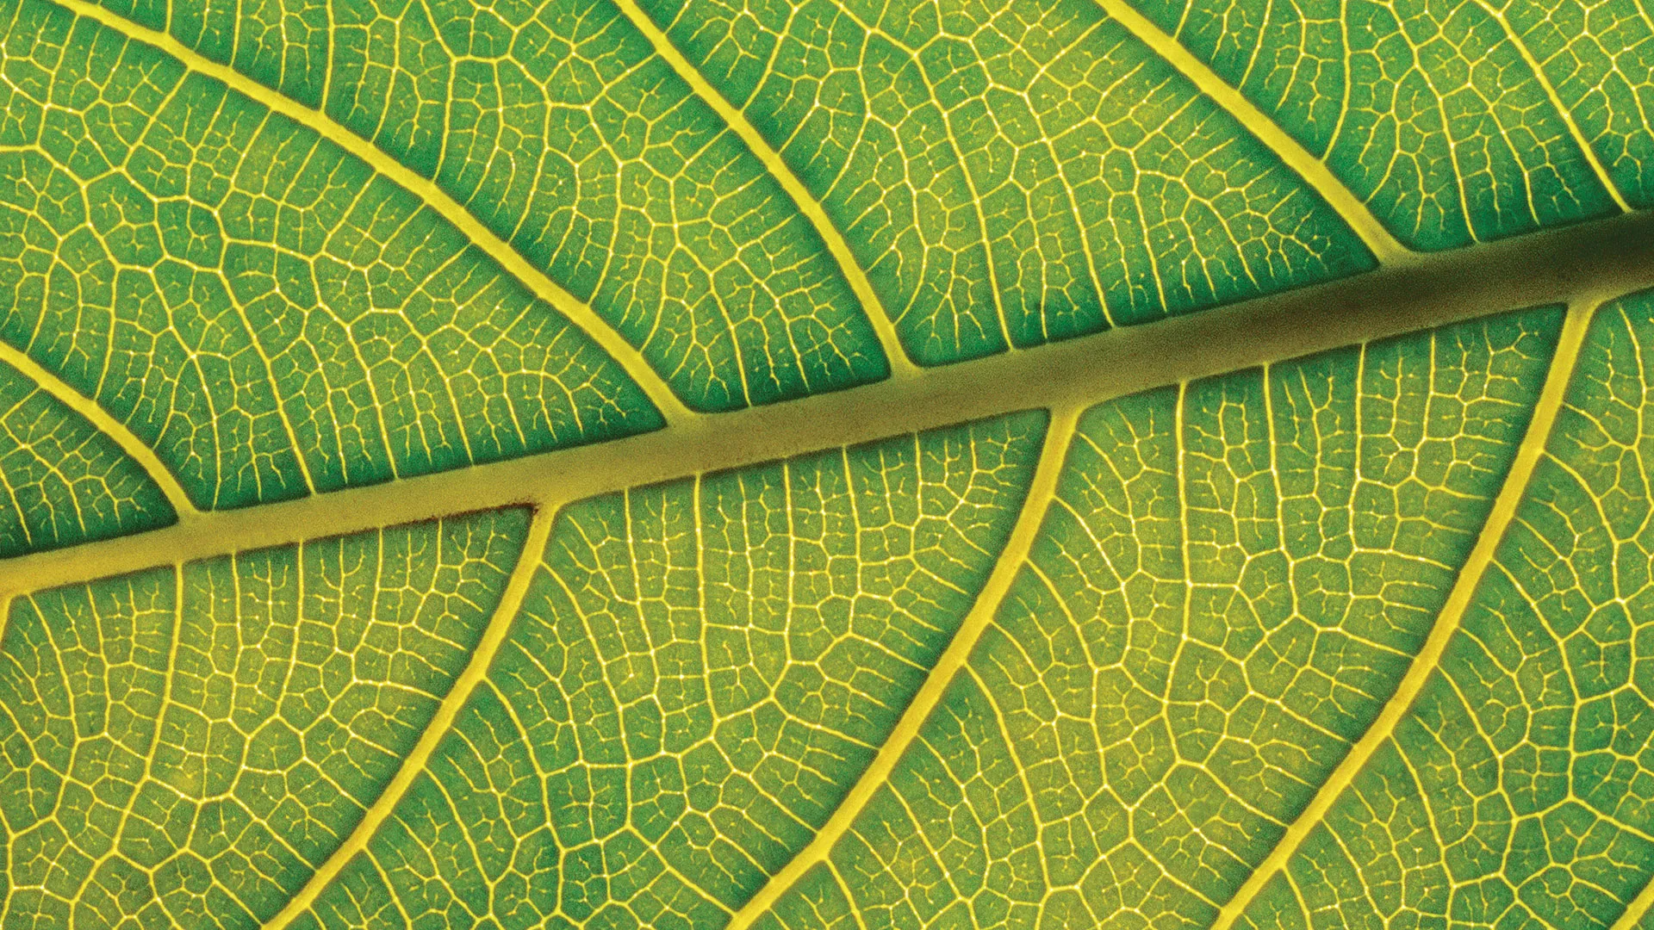
THANK YOU

